Slide 1
#1.1: Command Line and Navigating Files
Slides with “ARQ” are copied or adapted from Aaron R. Quinlan

Slide 2
Access the slides and files here:
https://github.com/j-berg/bioinformatics_bootcamp

Slide 3
Course Overview and Goals
Week 1 & 2:
Using the command line for bioinformatics
Week 3 & 4:
Basics of programming and writing simple tools in Python
Week 5 & 6
Statistics and visualization in R

Slide 4
Course Overview and Goals
Purpose of the course is to introduce you to the language and power of programming
Help you start thinking about how you can use programming and bioinformatics in your research
Determine which language is most applicable to you to start with

Slide 5
Class structure
Mondays/Wednesdays
Conceptual lecture with demonstrations
Fridays
Review session for weeks sessions
Troubleshooting homework problems together

Slide 6
Some words of advice
Just like learning any new language, programming takes time and can be difficult
With more practice, fluency will improve
Don’t be discouraged if you have to Google everything (I still do this daily, even with tasks I’ve done time after time)
Ask your classmates for help on Slack – troubleshoot together
Best way to learn is to break the code, troubleshoot it, find out why it didn’t work, and find out why the solution actually works

Slide 7
Pseudo-code
Using simplified language to plan your program
Helps keep your programming organized
Like outlining an essay before writing to keep it concise, focused, and flowing

Slide 8
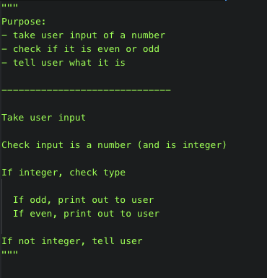
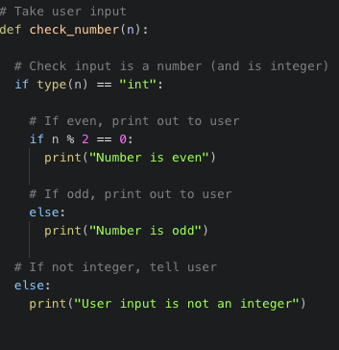
Pseudo-code

Slide 9
Logging onto the supercomputer
Computational biology tasks are resource intensive
Super-computing resources commonly need to be used
Lets you step away while the computer does the hard work
Or else you won’t be able to use your computer for a couple of days

Slide 10
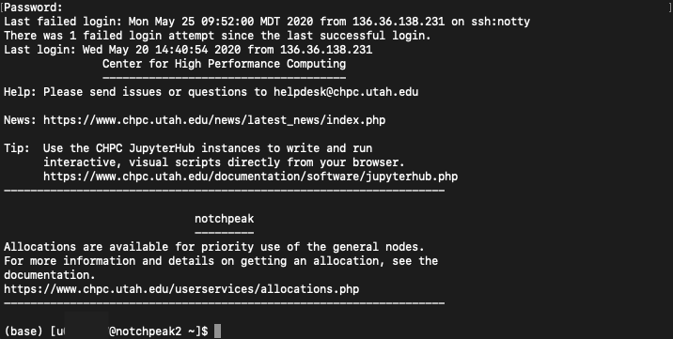
macOS
Open finder
Type “Terminal” and press enter
Type the following:
Verify host key
Password will not show characters while typing
To exit, type “logout”

Slide 11
Windows
Download PuTTY
“Host Name”: notchpeak.chpc.utah.edu
“Connection type”: SSH
Press the ‘Open’ button at the bottom of the dialog box, and PuTTY will begin trying to connect you to the server.
Verify host key
Enter the username and the password, and the server should grant you access and begin your session. If you have mistyped your password, most servers will give you several chances to get it right.
To exit, type “logout”

Slide 12
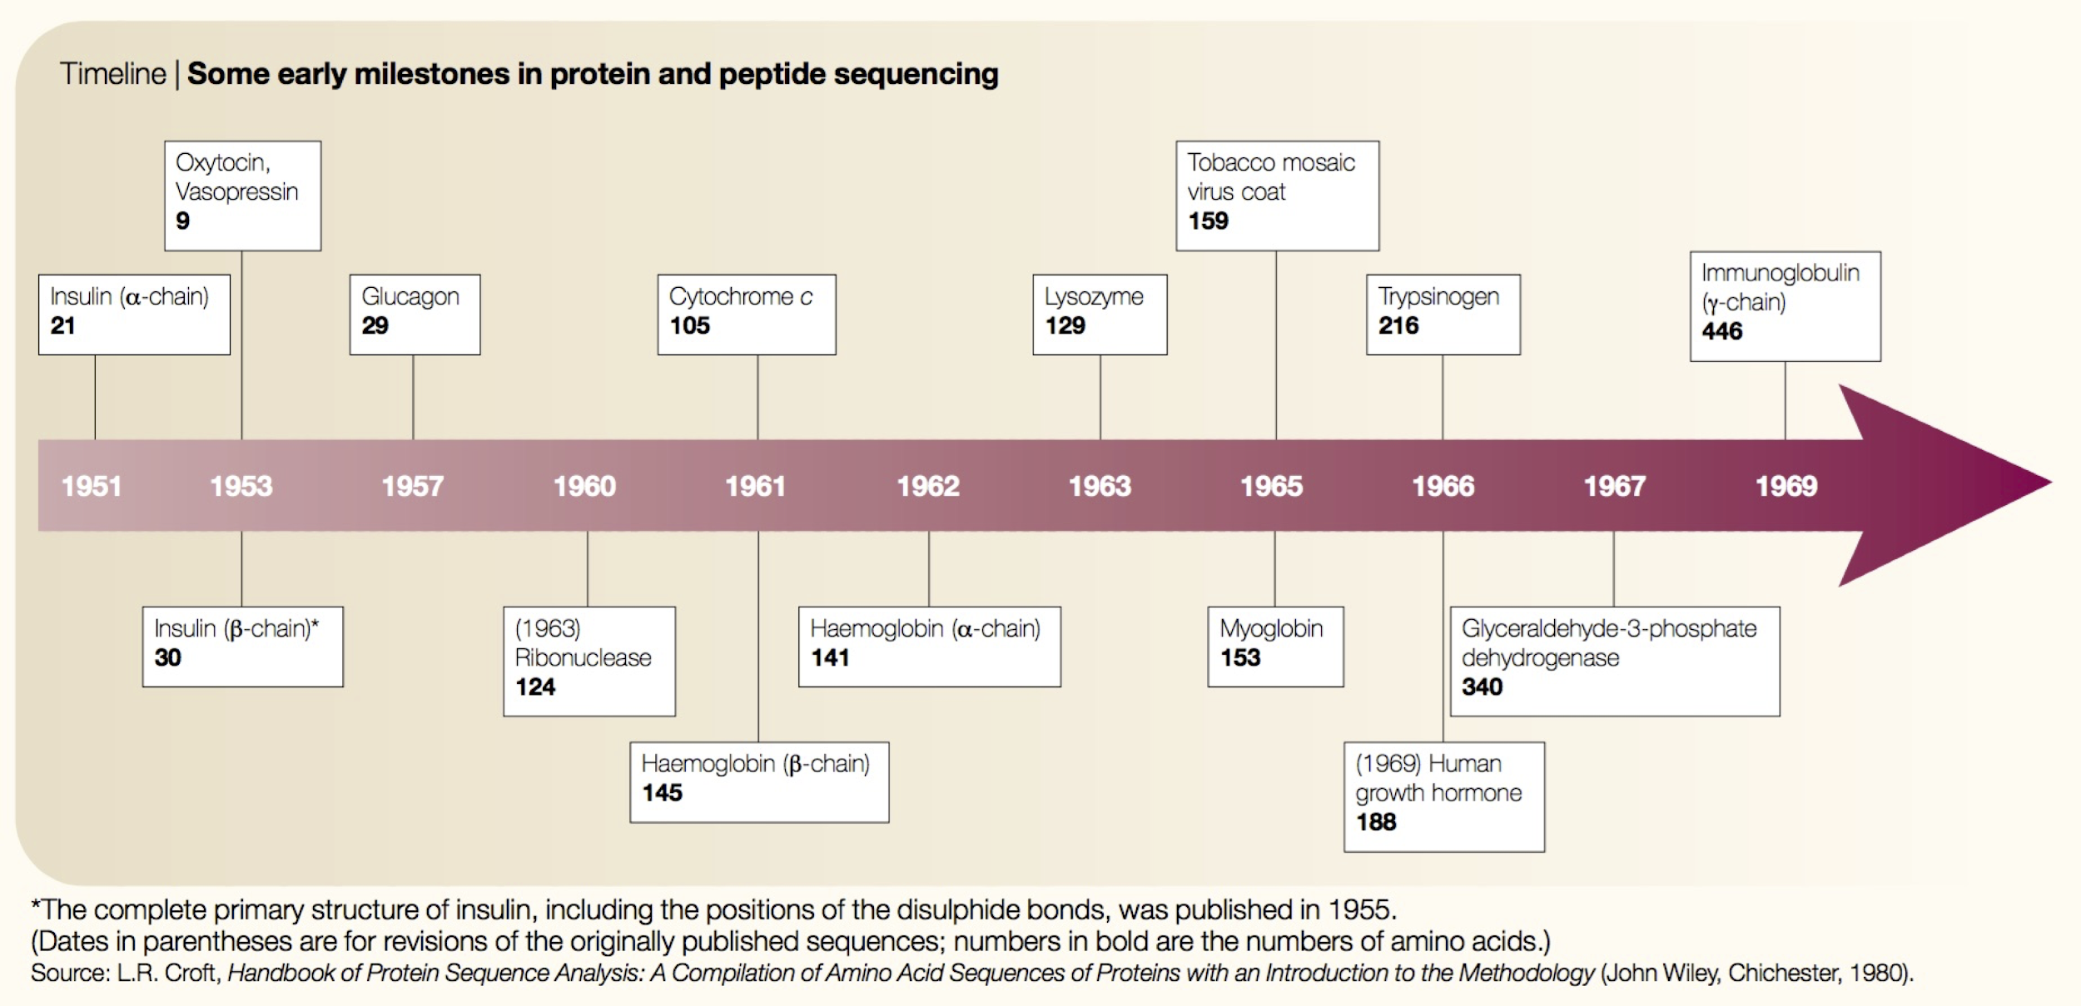
Comp. biology was born in the 1960s
ARQ
Began with amino acid sequencing in 1960’s
Need for computational power to answer questions and study protein biology
Scarcity of academic computers was no longer a major problem
Allows analyses that would take several lifetimes by hand
Joel Hagen, “The origins of bioinformatics”, NRG, Dec. 2000

Slide 13

What is Unix?
ARQ
Definition 1: Your interface with the underbelly of the computer
Definition 2: Where computational genomics is done.
Definition 3: Your dear friend.
Recommended reading: “The Evolution of the Unix Time-sharing system”, Dennis M. Ritchie https://pdfs.semanticscholar.org/f64f/6e66da16e93ebf4221fc8915b2420fd56b66.pdf

Slide 14

Unix history
ARQ
Ken Thompson (sitting) and Dennis Ritchie working together at a PDP-11
Initial file system, command interpreter (shell), and process management started by Ken Thompson
Vast array of simple, dependable tools that each do one simple task.
By combining these tools, one can conduct rather sophisticated analyses
Wildly popular platform for high performance computing. Supports parallelism.
Most computational biology tools come with a command line interface for using the tool.
Credit:https://en.wikipedia.org/wiki/History_of_Unix

Slide 15
Unix basics
ARQ

Slide 16
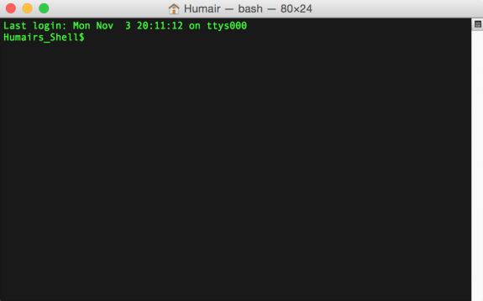
The “prompt”
ARQ
The prompt is just a patient little thing that waits around for you to tell it what to do via “commands”.
Command syntax must be exact. In this way, Unix is dumb. It cannot infer what you meant if you misspell, provide the wrong syntax, etc.

Slide 17
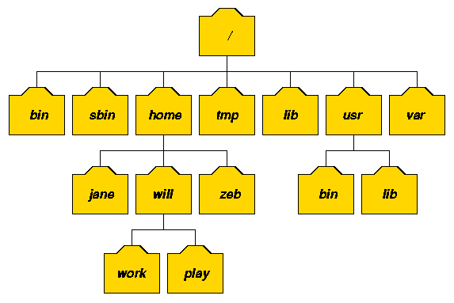
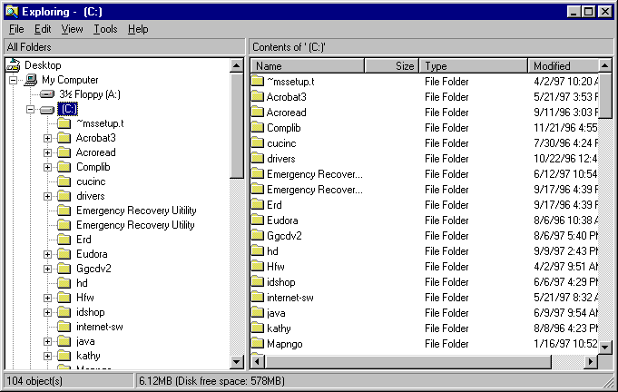
The Unix file system. A tree just like OSX and Windows
ARQ

Slide 18
I am lazy. You should be too. Shortcuts!!!
Go back to past commands with the arrow keys.
The history command will report the commands you have used in the past.
Type the "Ctrl" "r" keys at the same time to bring up a search for commands that contain search terms. Use the arrow keys to cycle through all commands that match the search term.
Use the "Tab" key for autocomplete - just like your smartphone!
Type the "Ctrl" "c" keys at the same time to kill a command.
ARQ

Slide 19
Spaces

Slide 20

The ls command (list files and directories)
(What files and directories can be found in the current directory?)
ARQ
Imagine we are user “luke”
Luke’s home directory (shortcut: ~)
root
list luke’s home directory
$ ls
hi.txt proj1
home
bin
vol
command
result to standard
output (stdout)
luke
leia
ls
head
cat
hi.txt
proj1
Example Unix file system (a “tree”)
data1.txt
data2.txt

Slide 21
The ls command (list files and directories)
(What files and directories can be found in the current directory?)
ARQ
Example Unix file system (a “tree”)
Imagine we are user “luke”
Luke’s home directory
root
list luke’s home directory
$ ls
hi.txt proj1
list luke’s home directory
$ ls ~
hi.txt proj1
home
bin
vol
luke
leia
ls
head
cat
hi.txt
proj1
data1.txt
data2.txt

Slide 22
The cd command (change directories)
(cd helps to navigate through the Unix directory tree)
ARQ
Example Unix file system (a “tree”)
Image we are user “luke”
list luke’s home directory
$ ls
hi.txt proj1
root
move to luke’s “proj1” directory
$ cd proj1
list luke’s “proj1” directory
home
bin
vol
$ ls
data1.txt data2.txt
Move “up” the tree to luke’s home directory
$ cd ..
$ ls
hi.txt proj1
luke
leia
ls
head
cat
Move “up” the tree to the “usr” directory
$ cd ..
$ ls
luke leia
hi.txt
proj1
$ cd luke/proj1
Move directly to luke’s “proj1” directory
data1.txt
data2.txt
$ cd /bin
Move to the system “bin” directory

Slide 23
The pwd command (present working directory)
(Where am I? That is, in which directory am I?)
ARQ
Imagine we are user “luke”
Example Unix file system (a “tree”)
root
Where am I?
$ pwd
/home/luke
move to luke’s “proj1” directory
$ cd proj1
home
bin
vol
Where am I?
$ pwd
/home/luke/proj1
luke
leia
ls
head
cat
move back to luke’s home directory
$ cd ..
Where am I?
$ pwd
/home/luke
hi.txt
proj1
data1.txt
data2.txt

Slide 24
The mkdir command (make a new directory)
ARQ
Example Unix file system (a “tree”)
Imagine we are user “luke”
root
Where am I?
$ pwd
/usr/luke
List luke’s home directory
$ ls
Hi.txt proj1
home
bin
vol
Move to the “proj1” directory
$ cd proj1
luke
leia
ls
head
cat
$ mkdir data
Make a new “data” directory in proj1
hi.txt
proj1
data1.txt
data2.txt
data

Slide 25
The touch command (create an empty file)
ARQ
Example Unix file system (a “tree”)
Image we are user “luke”
root
Where am I?
$ pwd
/usr/luke
List luke’s home directory
$ ls
Hi.txt proj1
home
bin
vol
$ cd proj1/data
Move to the “proj1/data” directory
luke
leia
ls
head
cat
Create an empty text file called “frost.txt”
$ touch frost.txt
hi.txt
proj1
data1.txt
data2.txt
data
frost.txt

Slide 26
The head command
(peak at the first n lines in an input file or stream)
ARQ
The contents of test.txt
$ cat test.txt
$ head -n 5 test.txt
Hello world!
1
2
3
4
Hello world!
1
2
3
4
5
6
7
8
9
Goodbye world!
$ head -n 10 test.txt
(notice how the last line -- line 11 – is not printed here)
Hello world!
1
2
3
4
5
6
7
8
9

Slide 27
The head command
(peak at the first n lines in an input file or stream)
ARQ
-n is an argument or parameter to the head command that modulates its behavior. In this case to report the first 5 lines instead of the first 10, which is the default behavior
The contents of test.txt
$ head -n 5 test.txt
Hello world!
1
2
3
4
5
6
7
8
9
Goodbye world!
\n
\n
\n
\n
\n
\n
\n
\n
\n
\n
\n
Hello world!
1
2
3
4
$ head -n 10 test.txt
Hello world!
1
2
3
4
5
6
7
8
9
Important!
Each line ends with a special, hidden character called the newline (\n) character.
This is how “head” knows where the lines start and end.
Notes:
Go over special characters

Slide 28
Convention: The "$" at the beginning of each command represents the shell prompt. Don't copy/paste it.
ARQ
$ head -n 10 frost.txt

Slide 29
What do you think the tail command does?
ARQ

Slide 30
The cat command
(report every line in an input file or stream)
ARQ
$ cat test.txt
Hello world!
1
2
3
4
5
6
7
8
9
Goodbye world!

Slide 31
The cat command: add line numbers with -n
(report every line in an input file or stream)
ARQ
$ cat -n test.txt
1 Hello world!
2 1
3 2
4 3
5 4
6 5
7 6
8 7
9 8
10 9
11 Goodbye world!

Slide 32
The wc command
(count the lines, words, and bytes in a file or stream)
ARQ
$ cat test.txt
How many lines words and bytes (characters) in test.txt?
$ wc test.txt
12 13 47 test.txt
Hello world!
1
2
3
4
5
6
7
8
9
Goodbye world!
How many lines (-l) in test.txt?
$ wc -l test.txt
12 test.txt
How many characters (-c) in test.txt?
$ wc -c test.txt
47 test.txt
Think: Is this the same as the number of nucleotides in the sequence?

Slide 33
Homework
Log into the supercomputer
Print your current working directory to the console
Make a folder called “class_1”
Navigate into this new folder
Make a new file called “test.txt” within the folder
Append “Hello World” to the file
Print out the number of lines in the file
Navigate back to your home directory
Logout

